Slide 1

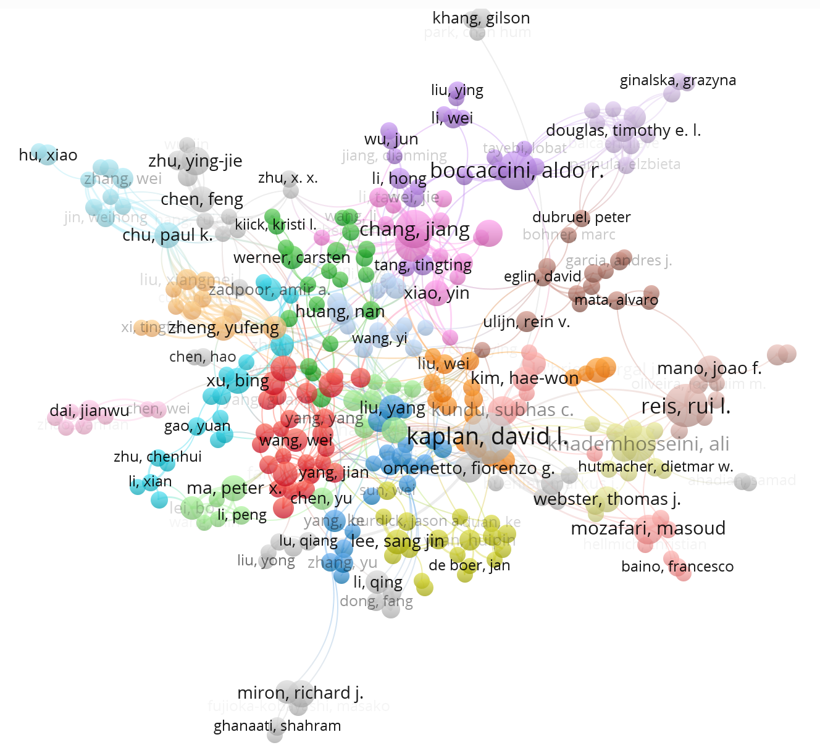
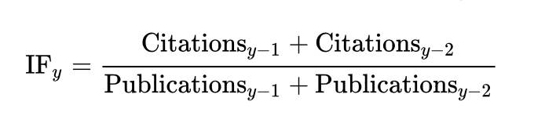
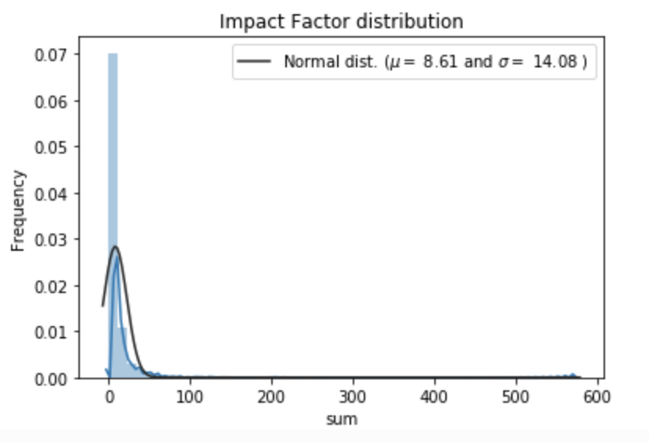
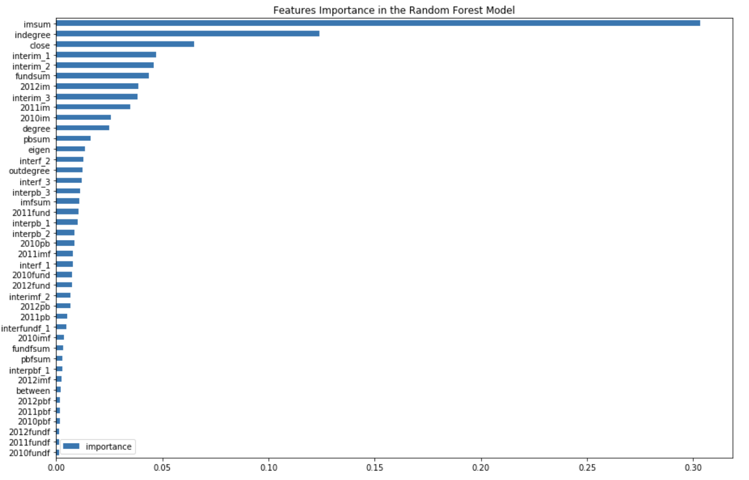
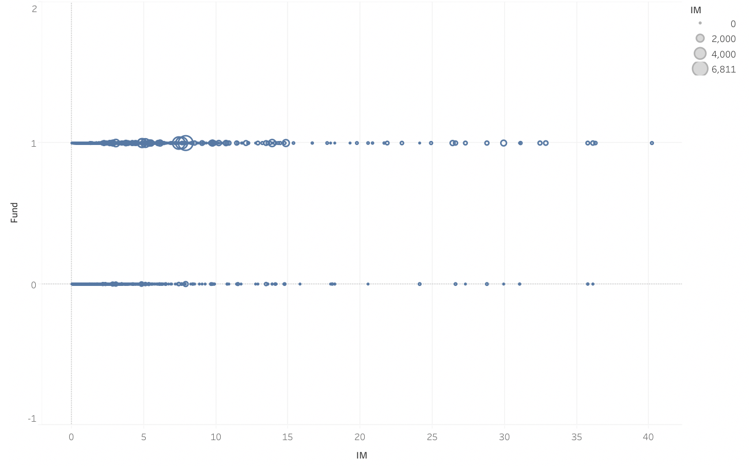
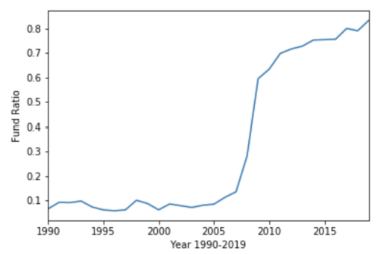
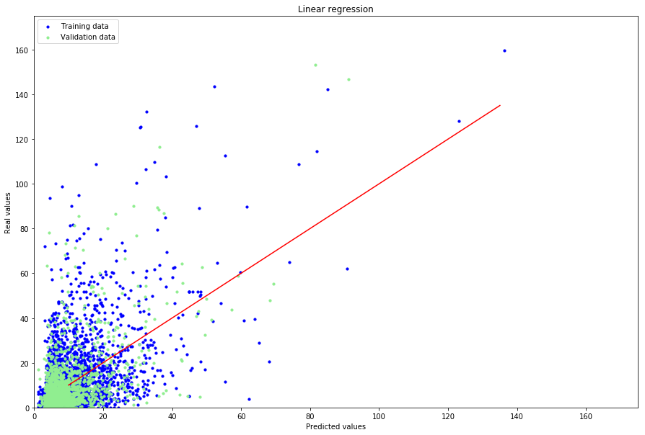
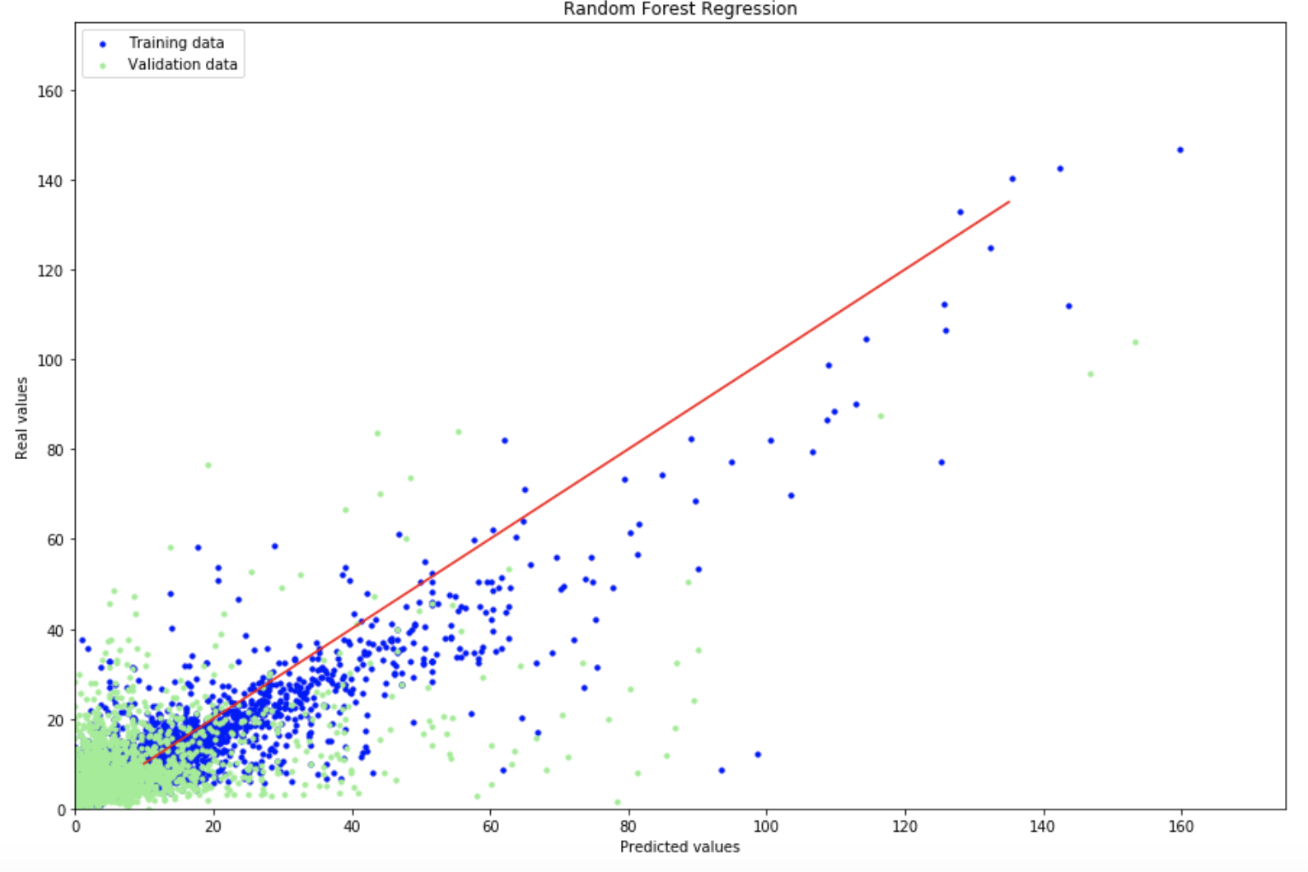
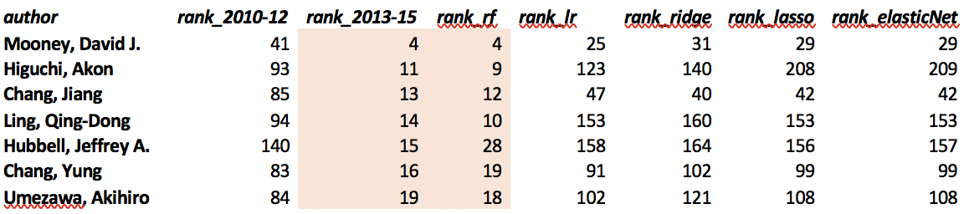
Bibliometrics Analysis of Authors (Wiley) Jiahui Bi, Hongyi Chen, Shan Gao, Yuyi Yan Instructor: Christopher Asakiewicz
Business Intelligence & Analytics
Motivation
The overall US publishing industry is financially healthy, as more and more authors are publishing papers every year. The average revenue of scientific journals have grown by nearly 60% from 2010 to 2017.
Publishers are looking for methods to identify predominant future authors in a specific scientific field.
Technology
Python for scrapping & cleansing the raw data from Web of Sciences
Gephi for creating visualizations of correlation between authors
Python & Tableau for generating visualizations of Correlation between Funding & Publishment
VOSviewer for generating co-authorship network visualization
Project Goal
Scraping Biometric & Biomaterial Data from Web of Science, pre-processing and converting it to author dataset.
Performing EDA on the author info to analyze the publication frequency, funding status and impact factor of journals published on
Spliting the dataset into two major time periods (2010-2012, 2013-2015) to create time gap in order to predict future leading authors
based on current features.
Using Social Network Analysis methodology to build co-author network and adding network features to the model.
Predicting the future leading authors based on the impact factor with Linear regression and Random Forest.
Impact Factor Analysis
Impact Factor is used to reflect the average number of citations divided by the total number of articles post on the journal recently. IF is frequently used as a proxy for relative importance of a journal. Higher IF indicates higher importance than lower ones:
We sum up the IF of the articles published by a certain author, considering the year of publication in the journal.
Total impact Factor of a certain author, during a time period, can reveal the quality of his published researches.
Modeling
Linear Regression with Ridge, Lasso, and ElasticNet, comparing with Random Forest.
Funding
Funded articles are more likely published on a journal with high Impact factor.
At 2009, funding & publication ratio has a cliff growth.
After 2010, more than 65% articles get funded.
Co-Authorship Analysis
The Co-authorship network is formed if two authors(node) co-authoring an article together(edge). The edges are directed from the lead author to the other authors. The larger the node is, the more paper the author published.
The authors with high centrality are always active corresponding authors, it’s a good indicator to consider their co-authorships to detect potential authors.
As it is a directed network, the outdegree and indegree of a certain node, reflect the information about the times the author act as the first author and the number of the research participated in.
Conclusion
We used two kinds of regression models. Linear regression with 4 different regularizations is more conservative than Random Forest, which explained a lower RMSE.
Random Forest model is more likely pick up potential top authors.
These models have advantages in picking top authors. (under top 50)
http://www.stevens.edu/howe/academics/graduate/business-intelligence-analytics

